Slide 1


Blazor
WebAssembly, Blazor, .NET in the Browser
SoftUni Team
Technical Trainers
Software University
http://softuni.bg

Slide 2
Table of Contents
WebAssembly
What is Blazor?
How is Blazor working?
Client-side and Server-side Blazor
Blazor in Details
Components, Routing and DI
Data Binding, Validation and Events
JavaScript Interop
MusicX – an example Spotify-like app

Slide 3
Have a Question?
sli.do #csharp-web

Slide 4
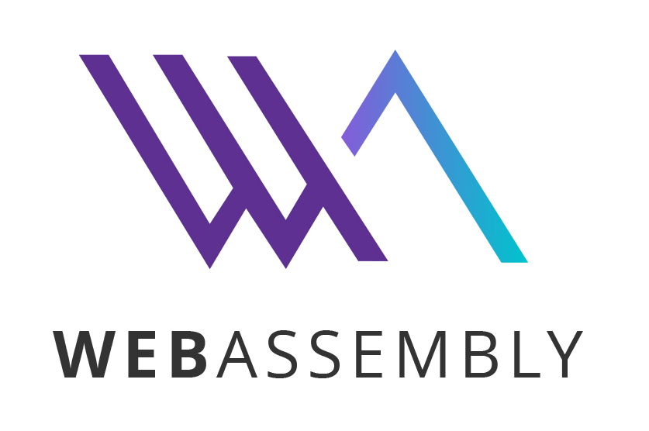
Web Assembly (WASM)
Executable code format for web pages

Slide 5
What is WebAssembly (WASM)?
WebAssembly is a binary instruction format for a stack-based VMs
W3C standard - https://webassembly.org
Lower level than JavaScript
Similar to a traditional assembly language with small instruction set
JS Interop
WebAssembly can work along with JavaScript in two-way integration
Supported by major browsers: https://caniuse.com/#feat=wasm
Polyfill: asm.js can execute .wasm files in JavaScript
It did before WebAssembly

Slide 6
How .NET runs in the WebAssembly?
The Mono runtime is the VM that runs .NET code for Blazor
Started as a separate project to run .NET on Linux
Now runs on WASM (browser), Xamarin (mobile apps) and Unity (games)
Supported by the .NET Foundation and Microsoft
Mono supports .NET Standard 2.1
Mono runtime is compiled to WebAssembly (mono.wasm file)
The actual .dll files are downloaded as-is and ran by the Mono runtime
Mono handles threads and garbage collection into the browser
Blazor uses Mono's IL Linker to reduce the size of your app
The whole Mono with the required dll files are about 4.5 MB

Slide 7

Blazor
Web-based UIs with C# and Razor

Slide 8
What is Blazor?
Blazor is a framework for building interactive client-side web UI with .NET
Create rich interactive UIs using C# instead of JavaScript
Share server-side and client-side app logic written in .NET
Render the UI as HTML and CSS (using Razor syntax)
Wide browser support, including mobile browsers
Blazor uses only the latest web standards. No plugins needed.
Do full-stack .NET development
Stay productive with Visual Studio on Windows, Linux, and macOS
Leverages ASP.NET Core advantages on both server and client
Benefit from .NET's performance, reliability, and security

Slide 9
What is Blazor?
Blazor is an open source component based web UI framework
Blazor is a full single-page application (SPA) framework
Inspired by the latest JavaScript SPA frameworks
Featuring support for offline/progressive web applications PWA
With app size trimming and browser-based debugging
Blazor supports 2 hosting models:
Client-side in browser on WebAssembly (ASP.NET Core 3.1)
Server-side as part of an ASP.NET Core (3.0) Components
The app and component models are the same on both models

Slide 10
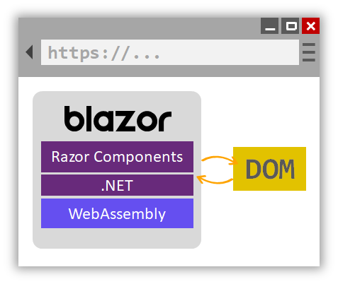
Client-side Blazor
Client-side Blazor runs in the browser on WebAssembly
The app is executed directly on the browser UI thread
It runs in the browser on a real .NET runtime (Mono) implemented in WebAssembly that executes normal .NET assemblies
JavaScript interop allows easily interact with your existing JS code
<p>Current count: @currentCount</p>
<button @onclick="IncrementCount">Click me</button>
@code {
private int currentCount = 0;
private void IncrementCount() {
currentCount++;
}
}

Slide 11
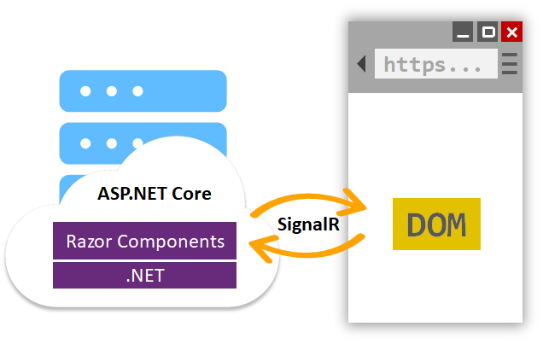
Server-side Blazor
The application is executed on the server from within an ASP.NET Core app
UI updates, event handling, and JavaScript calls are handled over a SignalR connection
Every user interaction involves a network hop
If the client connection fails, the app stops working

Slide 12
Client-side vs Server-side Blazor
Client-side apps don't have .NET server-side dependency
Client capabilities and resources are fully leveraged
Work is offloaded from the server to the client
Serverless deployment is possible (CDN)
Server-side apps code is not visible to the clients
Work with browsers that don't support WebAssembly
Download size is significantly smaller, latency – higher
Use of server resources and .NET Core compatible APIs

Slide 13
Get started with ASP.NET Core Blazor
Visual Studio 2019 16.3 Preview 1.0
With ASP.NET and web development workload selected
https://visualstudio.microsoft.com/vs/preview/
Install the latest .NET Core 3.0 Preview SDK release
SDK 3.0.100-preview7-012821
https://dotnet.microsoft.com/download/dotnet-core/3.0
Install the Blazor templates by running the following command:
dotnet new -i Microsoft.AspNetCore.Blazor.Templates::3.0.0-preview7.19365.7

Slide 14
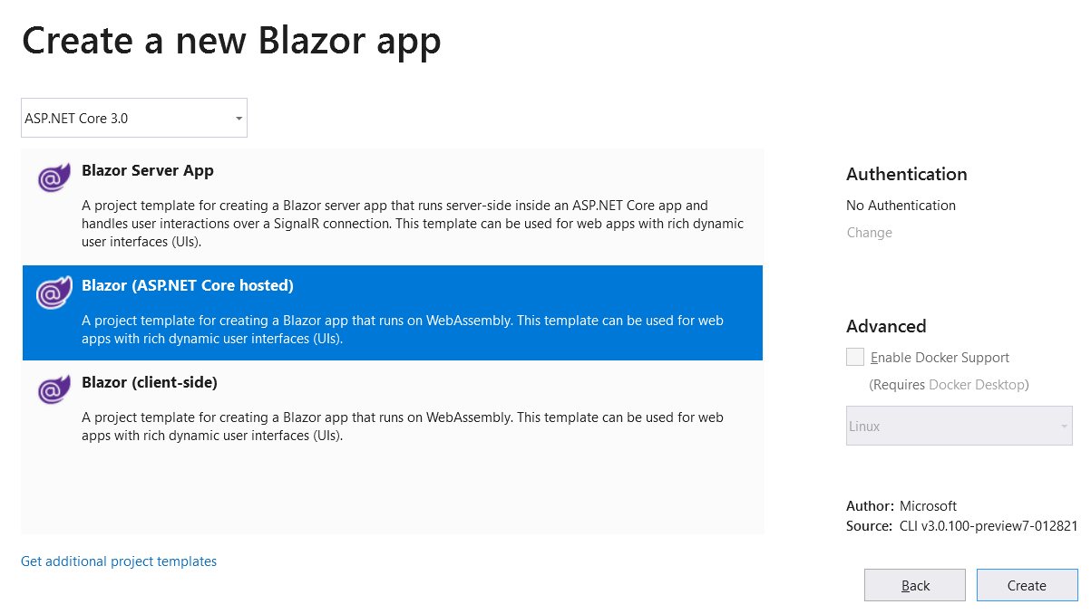
Blazor Templates Demo
Look inside the default Blazor templates

Slide 15

Blazor in Details
Components, Routing, DI, Data Binding, JS Interop

Slide 16
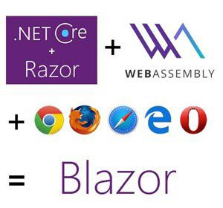
Blazor Features
A component model for building composable UI
Layouts, pages and components (using Razor)
Built-in routing (same ASP.NET Core rounting rules)
Two-way data-binding
Support for forms and validation (data annotations)
Easy dependency injection (similar to ASP.NET Core)
JavaScript interop (two-way)
Rich IntelliSense and tooling (Visual Studio 2019)
Full debugging both in browsers and in the IDE

Slide 17
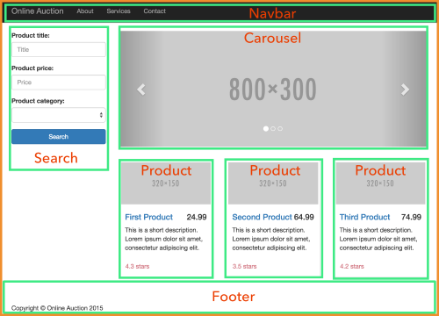
Components in Blazor
In Blazor everything in the UI is a component (as is in Angular)
Can be used to represent a single text field as well as a whole page
Component can contain any number of other components
Components are compiled to .NET classes
That’s where @using, @inject, @inherits, @code come into play in the .razor file
Components can have parameters
The base component is App.razor
_Imports.razor declares the MainLayout

Slide 18
Components in Blazor
@page "/ParentComponent"
<h1>Parent-child example</h1>
<ChildComponent Title="Panel title from parent">
Child content of the child component is supplied by the parent.
</ChildComponents>
ParentComponent.razor
<div class="panel panel-success">
<div class="panel-heading">@Title</div>
<div class="panel-body">@ChildContent</div>
</div>
@code {
[Parameter] private string Title { get; set; }
[Parameter]
private RenderFragment ChildContent { get; set; }
}
ChildComponent.razor

Slide 19
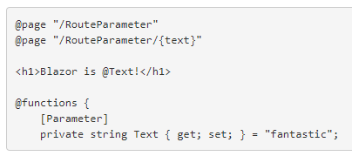
Routing in Blazor
When a .razor file with an @page directive is compiled
Then the generated class is given a RouteAttribute
This attribute specifies the route template
At runtime the Router looks for component classes with a RouteAttribute
Renders the component with route template, matching the request URL
Route parameters can be used to populate component parameters
Parameters are with the same name (route constraints can be applied)
Matching is case-insensitive

Slide 20

Dependency Injection
Blazor supports dependency injection (DI)
Registration is done in the ConfigureServices() method
In the Client web application's Configuration
Services can be Singleton and Transient (Scoped = Singleton)
Default services: IUriHelper, IJSRuntime and HttpClient
Using in components:
services.AddSingleton<IApplicationState, ApplicationState>();
@inject IApplicationState ApplicationState

Slide 21
Lifecycle of Blazor Components
Instantiate and resolve services
OnInit()
OnInitAsync()
@implements IDisposable
IDisposable.Dispose()
Resolve parameters
OnParametersSet()
OnParametersSetAsync()
Disposal
Resolve sub components
OnAfterRender()
OnAfterRenderAsync()
State has changed
Render component
this.StateHasChanged()

Slide 22
Data Binding in Blazor
Interpolation – same as in Razor
Conditional content and lists
<!-- Simple interpolation. In Angular, this would be {{ Count }}
-->
<p>Counter: @Count</p>
<!-- Conditionally display content In Angular, this would be *ngIf
-->
@if (ShowWarning) {
<p style="background-color: red; padding: 5px">Warning!</p>
}
<!-- Bind to a collection In Angular, you would do that with *ngFor
-->
<ul>
@foreach (var number in Numbers)
{
<li>@number</li>
}
</ul>

Slide 23
Data Binding in Blazor (2)
Style binding
Conditional CSS class
<!-- Style binding. In Angular, you would do that with [style.backgroundColor]="..."
-->
<p class="background-color: @Background; color=white; padding: 5px">Notification</p>
<!-- Add/Remove class In Angular, you would do that with [class.highlight]="..."
-->
<p class="note @((NoteIsActiove ? "hightlight" : ""))">This is a note</p>

Slide 24
Data Binding in Blazor (3)
Two-way binding
<!--
Angular two-way binding
<input [(ngModel)]="username">
-->
<input type="text" @bind="this.Name" /> <!-- onchange -->
<input @bind-value="CurrentValue" @bind-value:event="oninput" />
<input type="number" @bind="(this.Age)" />
<input type="text" @bind="this.Birthday" @bind:format="dd.MM.yyyy" />
<input type="checkbox" @bind="(this.IsAdmin)" />
<select id="select-box" @bind="(this.TypeOfEmployee)" />
<option value=@EmployeeType.Employee>@EmployeeType.Employee</option>
<option value=@EmployeeType.Intern>@EmployeeType.Intern</option>
</select>

Slide 25
Forms and Validation
Model file
Component code
using System.ComponentModel.DataAnnotations;
public class ExampleModel
{
[Required]
[StringLength(10, ErrorMessage = "Name is too long.")]
public string Name { get; set; }
}
<EditForm Model="@exampleModel" OnValidSubmit="@HandleValidSubmit">
<DataAnnotationsValidator />
<ValidationSummary />
<InputText id="name" @bind-Value="@exampleModel.Name" />
<button type="submit">Submit</button>
</EditForm>

Slide 26
Events in Blazor
Supported events: @onclick, @onchange, @onkeypress...
And many more: EventHandlers.cs
<!-- Angular -->
<button (click)="method()">...</button>
<button @onclick="Clicked">Click me</button>
<button @onclick="@(() => Console.WriteLine("Hello World!"))">Click me</button>
<input type="text" @onchange=@(e => Console.WriteLine(e.Value)) />
@functions {
private void Clicked()
{
Console.WriteLine("Hello World!");
}
}

Slide 27
JS Interop: Call JavaScript from .NET
Blazor and WebAssembly can't directly access the Browser's DOM
The JavaScript interop provides a means of filling the gap
window.myNamespace = {
showPrompt: function (message) {
return prompt(message, 'Type anything here');
}
};
@inject IJSRuntime JsRuntime;
<button @onclick="Prompt">Click here to show a prompt</button>
@code {
async void Prompt() {
var text = await
JsRuntime.InvokeAsync<string>("myNamespace.showPrompt", "So?");
}
}

Slide 28
Capture References to Elements
Some JS interop scenarios require references to HTML elements
To do so define a field of type ElementRef
Add a @ref attribute to the HTML element
The only thing you can do with ElementRef is pass it through to JavaScript code via JavaScript interop
<input @ref="username" />
@code {
ElementRef username;
}
window.jsInterop = {
focus : function (element) {
element.focus();
}
}
public async void SetFocus()
{
await JSRuntime.InvokeAsync<object>(
"jsInterop.focus", username);
}

Slide 29
JS Interop: Call .NET from JavaScript
To invoke a static .NET method from JavaScript, use the DotNet.invokeMethod or DotNet.invokeMethodAsync functions
All parameters should be deserializable from JSON
Generics and overloads aren't currently supported
To invoke a .NET instance method from JavaScript pass the .NET instance to JavaScript by wrapping it in a DotNetObjectRef instance
[JSInvokable]
public static Task<int> SomeStaticDotNetMethod() { return 2; }
// In JavaScript we can call it with:
DotNet.invokeMethodAsync('AssemblyName', 'SomeStaticDotNetMethod')
.then(data => { console.log(data); });

Slide 30

MusicX – an example Spotify-like app
Live Demo

Slide 31

Summary
…
…
…
WebAssembly
What is Blazor?
How is Blazor working?
Client-side and Server-side Blazor
Blazor in Details
Components, Routing and DI
Data Binding, Validation and Events
JavaScript Interop
MusicX – an example Spotify-like app

Slide 32
https://softuni.bg/trainings/courses

Slide 33












SoftUni Diamond Partners

Slide 34




SoftUni Organizational Partners

Slide 35




Trainings @ Software University (SoftUni)
Software University – High-Quality Education and Employment Opportunities
softuni.bg
Software University Foundation
http://softuni.foundation/
Software University @ Facebook
facebook.com/SoftwareUniversity
Software University Forums
forum.softuni.bg

Slide 36

License
This course (slides, examples, demos, videos, homework, etc.) is licensed under the "Creative Commons Attribution-NonCommercial-ShareAlike 4.0 International" license

